Slide 1
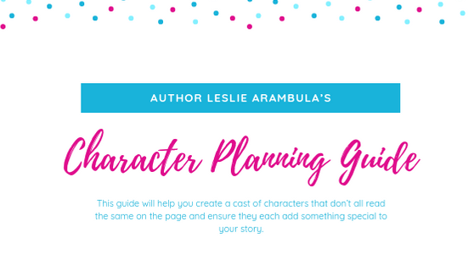

Slide 2
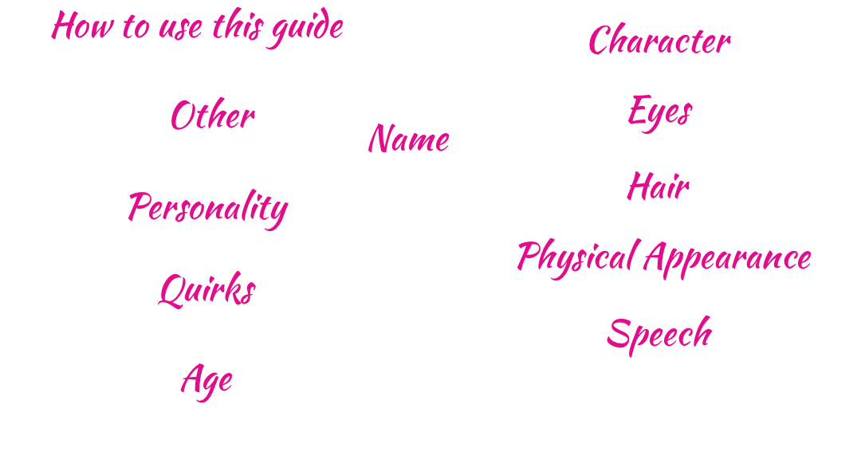
Option 1: Prewriting
This guide can be a great way to brainstorm your characters. By going through each section, you will make sure that you have enough to start writing, and can add on as you create more and more characters. This makes a great reference sheet for details as you write your first draft and beyond.
Option 2: Drafting
Sometimes, we get in the middle of our writing process and realize we don’t know enough about our characters. Or maybe they all sound the same. Or you just realized half your character names start with the letter J.This can be a great tool to help you identify the areas of weakness in your cast of characters so that you can adjust and move forward.
Option 3: Revising
After feedback from a critique partner or beta reader, you may have to adjust some of your characters. By filling out this guide, you can identify where you need to make changes, but also ensure that your changes don’t mimic an already established character and ensure they each add something special to your story.

Slide 3
Questions to consider
Do your character names start with the same letter/sound?
Do they end with the same letter/sound?
Are they all the same amount of syllables?
Are all names of varying length?
Do the names fit the time period/setting?
Is it something that is confusing or difficult to pronounce?
Examples
In The Lord of the Rings, characters have long and short names, varying sounds, different backgrounds, and variety. One pair of names that was always confusing to me was Sauron and Saruman because of their similar sounds and spellings.
Aragorn
Boromir
Bilbo
Frodo
Samwise
Galadriel
Isildur

Slide 4
Are all of your characters the same age? Do you have a really good reason to do that?
How does one character react differently due to another because of age/experience?
What is each characters job? Is it age appropriate? If not, is there a reason why?
What role does each character’s age play in the society that they are a part of?
What knowledge is common of people in each character’s age range? (Teenagers and the elderly typically have interest differences)
In James Dashner’s The Maze Runner, all of the characters that we first meet are teenagers. Thomas is sixteen, and all of the other Gladers, even Teresa when she shows up, are in their teens. And they’re all boys. There is a specific reason for this (which I won’t spoil here), but Dashner set it up so that this sort of environment works for the story that he is writing. However, despite their age range being fairly limited, the characters are still given interests, strengths, and weaknesses that are diverse.

Slide 5
Color? Shape? Length? Style?
Does your character wear makeup? How much? How often?
Does your character wear glasses? Contacts?
Does your character have a specific reason for their hair style or physical traits? How is it related to where they live, or who their family is?
Is your character wearing colored contacts for a specific reason? Or just because they like the change?
How often does your character get their hair cut or dyed?
In The Hunger Games by Suzanne Collins, characters are part of districts, and many of their physical traits have something to do with that. For example, Katniss has the look of someone who comes from “The Seam,” which is where she lives. This means olive skin, gray eyes, and dark hair. However, her own sister has the “merchant” look, with pale hair and skin, and blue eyes. Even thought they are characters who come from the same place, and even the same family, they have differences. However, these differences are included for reasons that help build the world of Panem.

Slide 6
Do any of your characters have noticeable scars?
Do they walk with a limp or favor one side over the other?
Does your character have any injuries or illnesses that are noticeable right away?
What is your character’s body type or build?
Does a character have facial hair, wrinkles, moles, etc.?
The main character in Alison Goodman’s Eon is labelled as a cripple who limps due to a bad leg. When introduced, this has significant effects on the way the character deals with things, and is treated by others.
“I tensed and stepped back. Too fast. The sand shifted under my bad leg, wrenching it to the right…My hip! Had I done more harm to my hip?”
“‘Get up Eon-jah. You’re an insult to the Dragoneye profession.’”
Page 5

Slide 7
Is your character soft spoken, or always really loud?
Do they speak in long or short sentences?
What type of vocabulary do they use?
Do your characters use slang? Or favor cliches? Or constantly use metaphors?
Does your character have an accent that is noticeable in their dialogue lines?
Does your character slur? Why?
One of the easiest examples for me to find of varied speech patterns is definitely Hagrid from JK Rowling’s Harry Potter and the Sorcerer’s Stone. Here’s an example of an exchange between Harry and Hagrid, and you don’t even need the dialogue tags to tell who is who:
“Ministry o’ Magic messin’ things up as usual.”
“There’s a Ministry of Magic?”
“‘Course…They wanted Dumbledore for Minister, o’ course, but he’d never leave Hogwarts.”
Page 65

Slide 8
Does your character pace? Or drum his/her fingers when impatient?
Does your character always keep a particular item with him/her? How does that show up in his/her scenes?
Does your character have the impulse to touch everything?
Does your character interrupt constantly?
What does your character notice first when they walk in the room or meet someone new?
How does your character address other characters?
Even when I had to put down Ruta Sepetys’s Salt to the Sea, it was easy to tell which of the four character POVs I had left off on. Joana would called Florian “The Prussian” and as a nurse, she was concerned with health related things. Florian’s POV chapters, however, usually referred to other characters without using their names. Instead he’d say pink cap or old man when talking about them. He was also quick to analyze the behaviors and motives of others, since he was always worried someone would find out his secret. He also always kept a close eye on his belongings which stood out to
other characters.

Slide 9
What Myers-Briggs personality type are your characters?
Do they follow their horoscopes?
Are characters religious? Spiritual?
Does your character follow the rules or constantly break them?
What sets your character off? What makes them cry? What do they do to relax?
Is your character active or responsive?
Does your character make friends easily or struggle to socialize?
What does your character value?
Ryber Fortiza in Susan Dennard’s Sightwitch is a stickler for rules. She lives her life by the rules of the convent that she is a part of in the hopes that it will result in her receiving the Sight. This affects not only her daily life, but the way her relationships are formed as well.
“‘Your bed is not made right,’ Ryber pointed out earlier… ‘The lanterns are snuffed out at the twenty-first chimes, and lighting a candle after that would be breaking Rule 33.’”
Page 30

Slide 10
What is your character’s sexual orientation?
What is each character’s race/ethnicity? How has that shaped his/her experience?
What hobbies does your character have? Pet peeves?
What social class does each character come from?
What was his/her home life like as a child? What is it like now?
What is your character interested in? How does that show in his/her scenes?
Throughout the Throne of Glass series by Sarah J. Maas, it is clear that the main character has an eye for nice things, expensive things. In Queen of Shadows a bridge is gapped when Aedion takes in the “small, wood-paneled room decorated with care and a penchant for the luxurious.” He knows, and readers get a glimpse at the way that Celeana Sardothien’s desire to buy things in the first book play into an overarching trait of her need for luxury and fine things. These help set her apart, but also lay clues once the big reveal about her identity happens as to why she has such fine tastes.

Slide 11
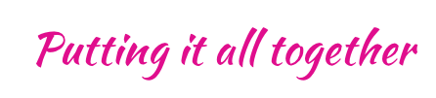
After you’ve taken a look at all of the different sections above, you can start to chart your cast of characters and look for patterns or gaps in the creation of your story. One simple way to do this is to create a spreadsheet or chart and fill it out for your main characters. Here’s just a piece of what that might look like using Adam Silvera’s main characters from They Both Die at the End.
Character Name | Age | Physical Appearance | Speech | Personality
Mateo Torrez | 18 | 5’10 Puerto Rican 164 lbs. | Calculating about his words, hesitant in the delivery of them | Shy, reactive, introverted, nerdy, doesn’t feel confident
Rufus Emeterio | 17 | 5’ 10 Cuban-American 169 lbs. Gym shorts and hoodies Athletic build | Heavy slang usage; informal; lots of questions | Outgoing, impulsive, loyal, intense

Slide 12

Using that chart, it is easy to see the areas that the boys are similar, but also the things that set them apart, like their personalities and speech patterns. This helps the boys to come across the page as two separate entities, despite similarities of age and situation.
You can do similarly with your own characters. List out the major characters and then see what brings them together, and why, but also, what sets them apart.
How will readers identify differently with each one? And how will they tell each of them apart in your story?
In revision, this can be an easy way to check your characters. If everyone is too similar, now you have a specific lens, like speech, that you can target on the next read and fix characters‘ lines to make them stand out more.

Slide 13
Sources
Collins, Suzanne. The Hunger Games. Scholastic, 2009.
Dashner, James. Maze Runner. The Fever Code. Delacorte Press, 2016.
Dennard, Susan. Sightwitch: the True Tale of the Twelve Paladins. Tor Teen, 2018.
Goodman, Alison. Eon: Dragoneye Reborn #1. Viking, 2008.
Maas, Sarah J. Queen of Shadows: a Throne of Glass Novel. Bloomsbury, 2016.
Rowling, J. K., and Mary GrandPre. Harry Potter. Scholastic, 1998.
Sepetys, Ruta. Salt to the Sea. Penguin Books, 2017.
Silvera, Adam. They Both Die at the End. HarperCollins, 2018.
Tolkien, J. R. R. The Lord of the Rings: the Fellowship of the Ring. HarperCollins, 2001.
Thanks for checking this out! I hope it helps you like it has helped me!
For more info and upcoming Freebies, visit my website at bit.ly/creatingfirstdrafts

